Slide 1











SRM Institute of Science and Technology
Potheri, SRM Nagar, Kattankulathur
Department of Computer Science
MULTI-DISEASE PREDICT SOFT-WEB
APPLICATION
NAME: RUBAN KUMAR R
REGISTER NO: RA2232017010006
GUIDE NAME:
Dr.P.YOGALASKSHMI

Slide 2
Abstract
In the face of increasing health challenges, the "Multiple Disease Prediction Software Web Application" project strives to address a critical concern: the proactive identification and prediction of various diseases for effective healthcare management. Fueled by the rising complexity of healthcare data and the need for personalized and timely interventions, this initiative aims to revolutionize disease prediction, prevention, and management through the integration of advanced machine learning techniques.

Slide 3

Problem Statement
Many of the existing machine learning models for health care analysis are concentrating on one disease per analysis. For example first is for liver analysis, one for cancer analysis, one for lung diseases like that. If a user wants to predict more than one disease, he/she has to go through different sites. There is no common system where one analysis can perform more than one disease prediction. Some of the models have lower accuracy which can seriously affect patients' health. When an organization wants to analyse their patient's health reports, they have to deploy many models which in turn increases the cost as well as time Some of the existing systems consider very few parameters which can yield false results.

Slide 4




Literature Survey
Auth: Jennifer Brown,
David Wilson
Auth: Daniel White, Olivia Harris
Machine Learning Approaches for Diabetes Prediction and Risk Factor Identification
Machine Learning Techniques for Lung Cancer Prediction: A Comprehensive Review
Vision
2019
2021
2019
Start
Auth: John Smith, Emily Johnson
2020
Authors
Application of Machine Learning in Disease Prediction: A Review
2018
2020
Auth: Sarah Thompson,
Michael Davis
Auth: Robert Garcia,
Amanda Martinez
Auth: Emma Clark, Sophia Roberts
Predictive Modeling for Heart Disease Detection Using Machine Learning Techniques
Early Detection of Parkinson's Disease Using Machine Learning Techniques
Predicting Breast Cancer Risk Using Machine Learning Techniques: A Review

Slide 5



Specifications
Hardware
Software
Python Tool
Specification
Specification
Specification
Processor : Core 13/15/17
Ram : 2-4 GB
HDD : 500 MB
Platform : Windows XP/7/8/10
Coding Language : Python
Numpy = 1.21.4
Pickle-mixin = 1.0.2
Scikit-learn = 1.0.1
Streamlit = 1.2.0
Streamlit-option-menu = 0.3.2

Slide 6
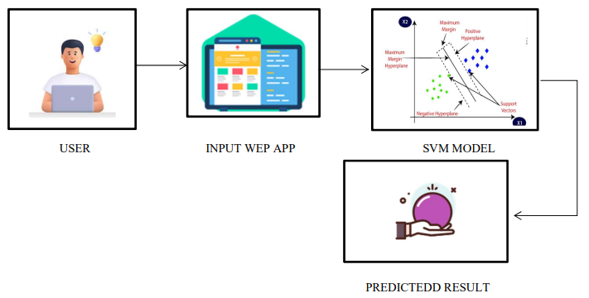
System Architecture
SVM
Support Vector Machine Architecture

Slide 7
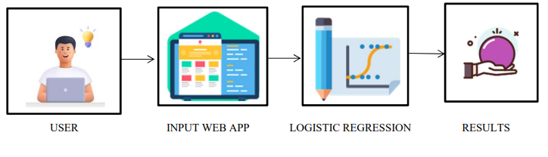
System Architecture
Logistic
Regression
Architecture

Slide 8
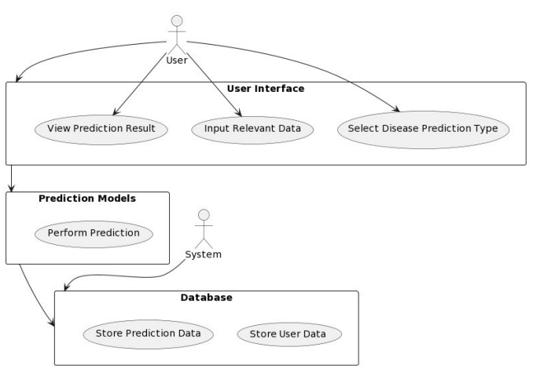
UML Diagram
PowerPoint
Presentation
PowerPoint
Presentation
PowerPoint
Presentation

Slide 9
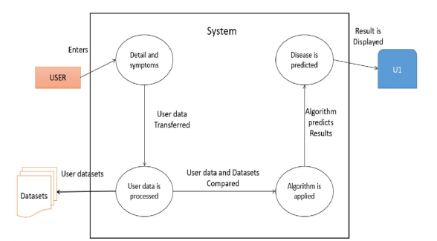
Dataflow Diagram
1
2
3
4

Slide 10
Dataset
Diabetes
This dataset contains information about various attributes of patients whether they are diabetic or not (Outcome column). It seems to be used for predicting diabetes based on these attributes.
80%
Each dataset serves as the basis for predictive modeling tasks, where machine learning algorithms are trained to make predictions or classifications based on the provided features.
Heart disease
This dataset contains information about various attributes related to heart health.
The target variable 'target' indicates whether the patient has heart disease (1) or not (0)
85%
Parkinson’s Disease
This dataset seems to be related to Parkinson's disease. It contains various biomedical voice measurements from people with and without Parkinson's disease. The 'status' column indicates whether a person has Parkinson's disease (1) or not (0).
87%
Breast Cancer
These datasets are essential for understanding and developing models for diagnosing or predicting various medical conditions.
This dataset contains features computed from a digitized image of a fine needle aspirate (FNA) of a breast mass. The target variable 'diagnosis' indicates whether the breast mass is malignant (M) or benign (B).
80%
Lung Cancer
This dataset seems to be related to lung cancer. It contains information about various attributes of individuals, such as their age, smoking history, and alcohol consumption, along with the result of a lung cancer test ('Result' column)
91%

Slide 11
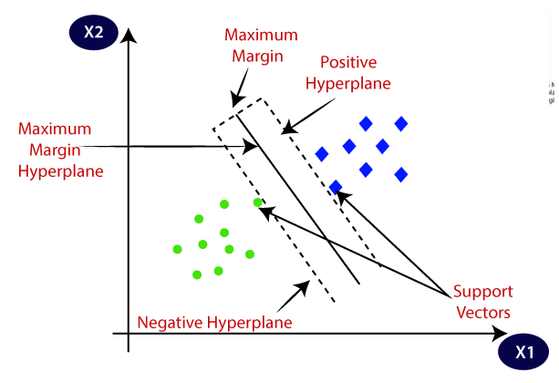
Algorithm Used
Support Vector Machines
SVM
Support Vector Machines is a directed learning calculation utilized for classification and relapse errands. It works by finding the hyperplane that best isolates the classes in the highlight space. In a twofold classification issue, the hyperplane points to maximize the edge between the two classes, which makes a difference progress the generalization of the model. Support Vector Machines (SVM) are broadly utilized in different spaces, counting healthcare, where they have been connected to errands such as diagnosing diabetes infection and Parkinson's infection based on understanding information. By using a support vector machine (SVM), this model predicts based on symptoms whether the person has a disease or not.

Slide 12
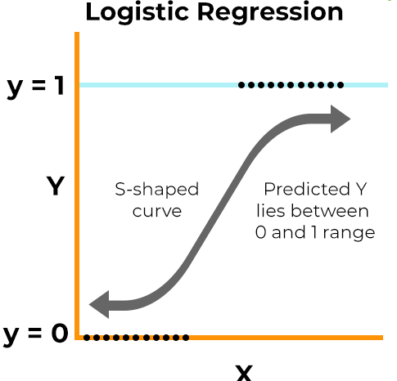

Logistic Regression
Calculated Relapse is a measurable show utilized for parallel classification assignments. In spite of its title, it's basically utilized for classification or maybe than relapse. Calculated relapse gauges the likelihood that a given input has a place to a certain lesson. It’s employments the calculated work (sigmoid work) to outline input highlights to probabilities between 0 and 1.
Algorithm Used
Logistic Relapse is commonly utilized in therapeutic investigate and healthcare applications, encouraging the expectation of results such as breast cancer, heart infection, and lung cancer, utilizing understanding information for investigation and determination. By using logistic regression, this model predicts based on symptoms whether the person has a disease or not.

Slide 13
Module Description
Data Collection Module
Disease Prediction Module
This stage (collecting historical data), whether it be from text files, Excel, Access, or other sources, lays the groundwork for future learning. The machine's learning chances improve with the variety, density, and amount of pertinent data.
01
04
The persistent will depict all of their illness-related side effects. At that point, in an exertion to compile as much data as conceivable, the framework will inquire questions with respect to certain components of their wellbeing.
Preparing the data Module
Logistic Regression
The quality of the data utilized is essential to any analytical procedure. Determining the quality of the data takes time, as does addressing problems like missing data and handling outliers. One way to examine the subtleties of the data in depth and increase the nutritional content may be via exploratory analysis.
02
05
By using logistic regression, this model predicts based on symptoms whether the person has a disease or not.
Training a model
Support Vector Machine(SVM)
The process involves selecting the appropriate algorithm and data representation for the model into two parts train training data and test data
03
06
By using a support vector machine (SVM), this model predicts based on symptoms whether the person has a disease or not.

Slide 14
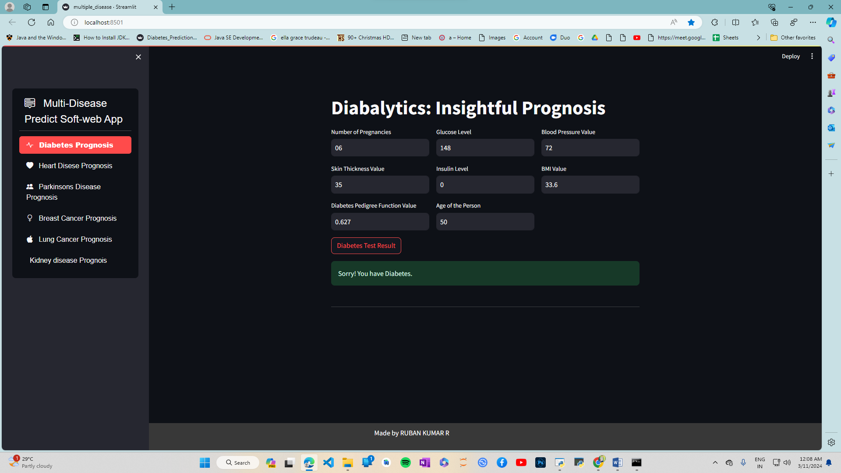

Input and Output Screen Shots
For Diabetes

Slide 15
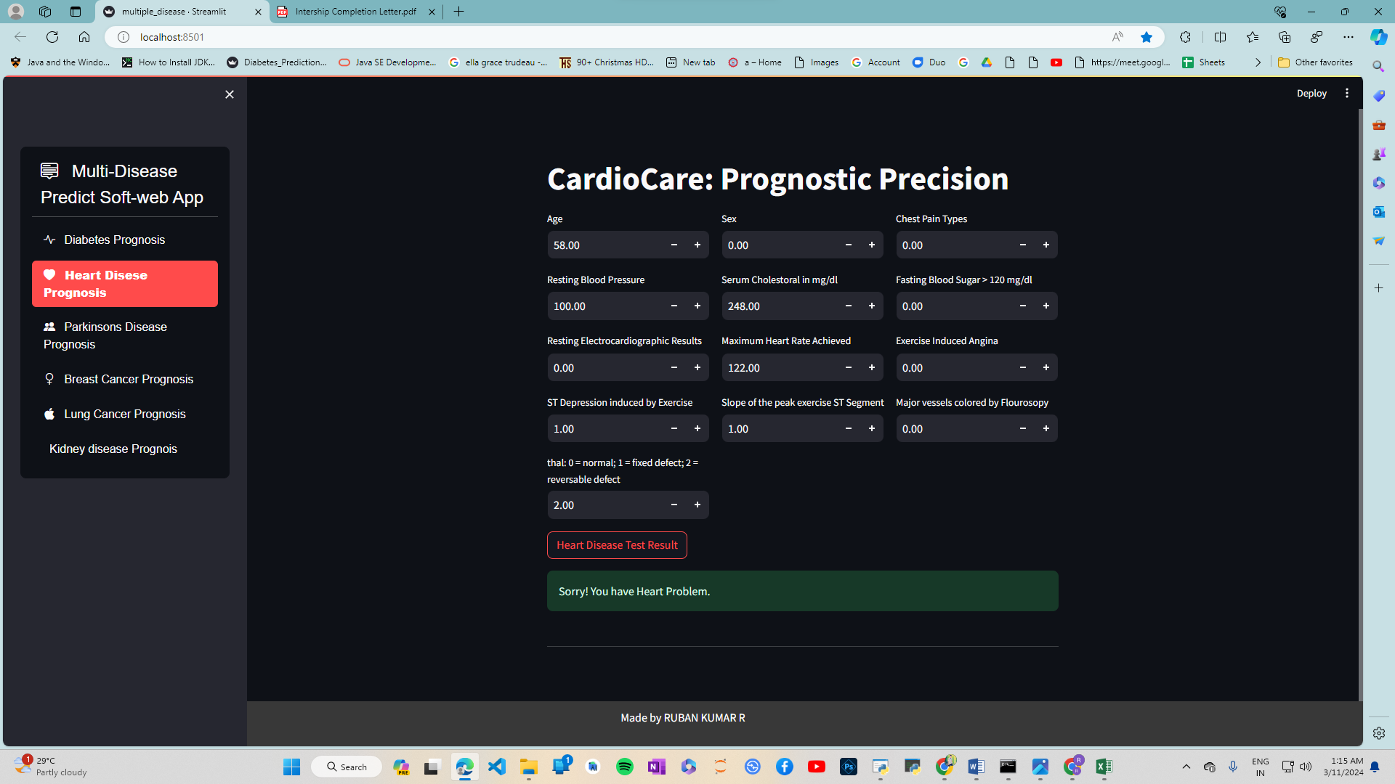

Input and Output Screen Shots
For heart disease

Slide 16
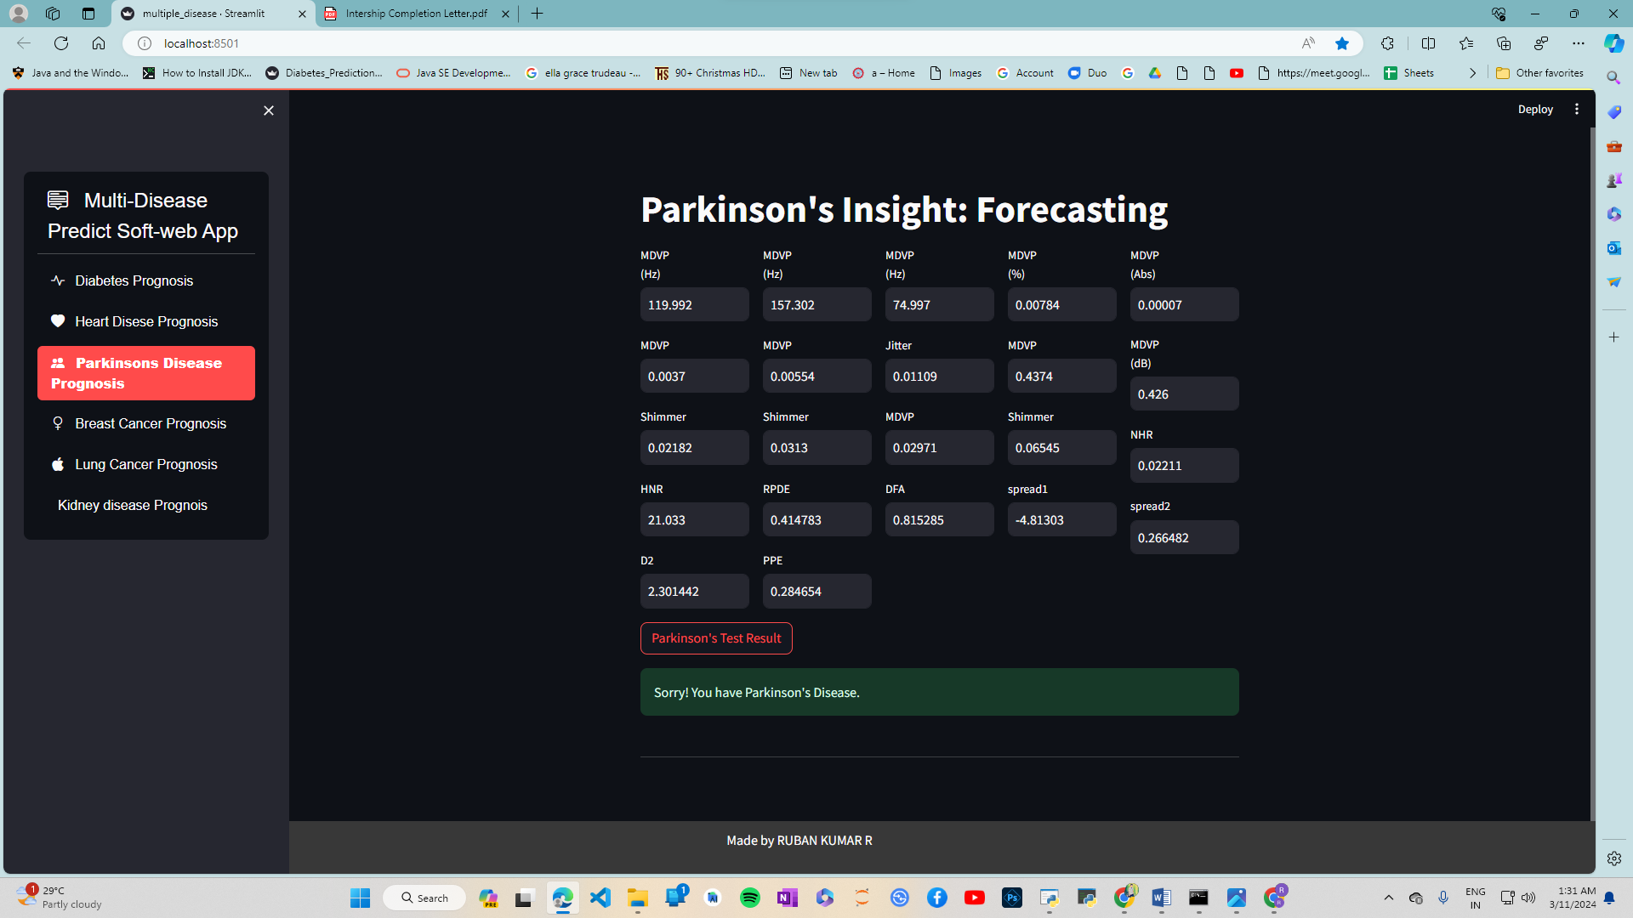
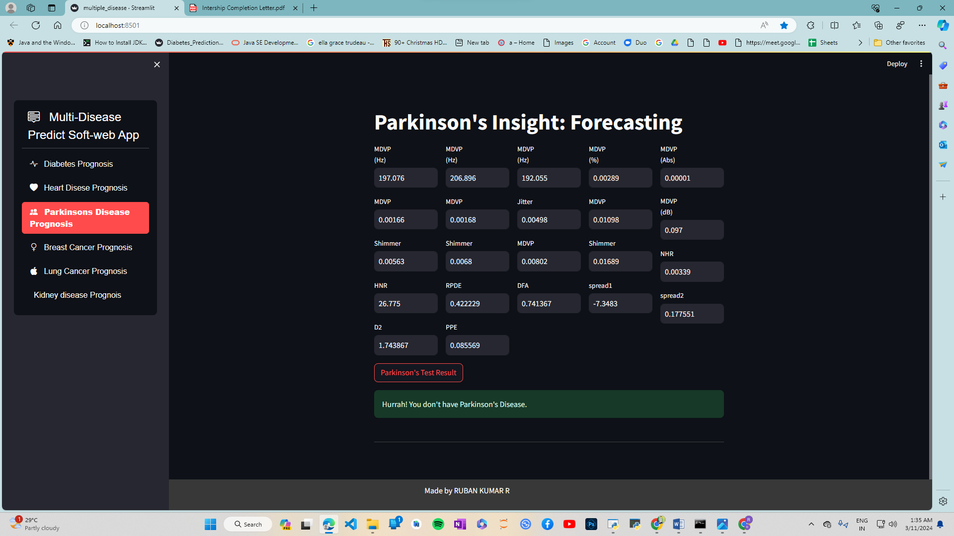
Input and Output Screen Shots
For Parkinson’s disease

Slide 17
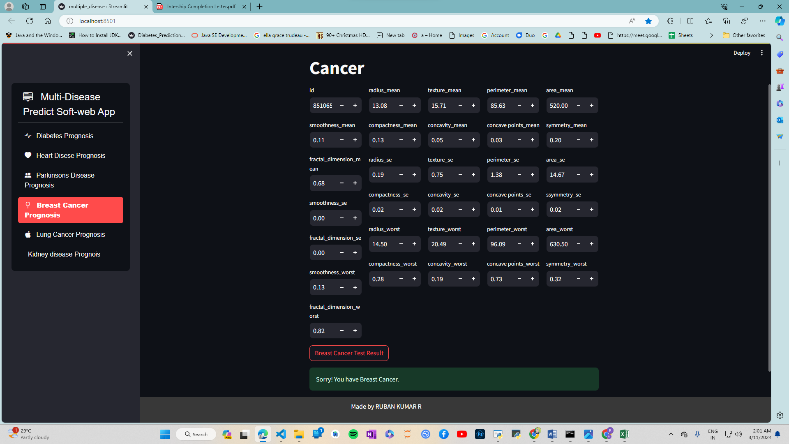
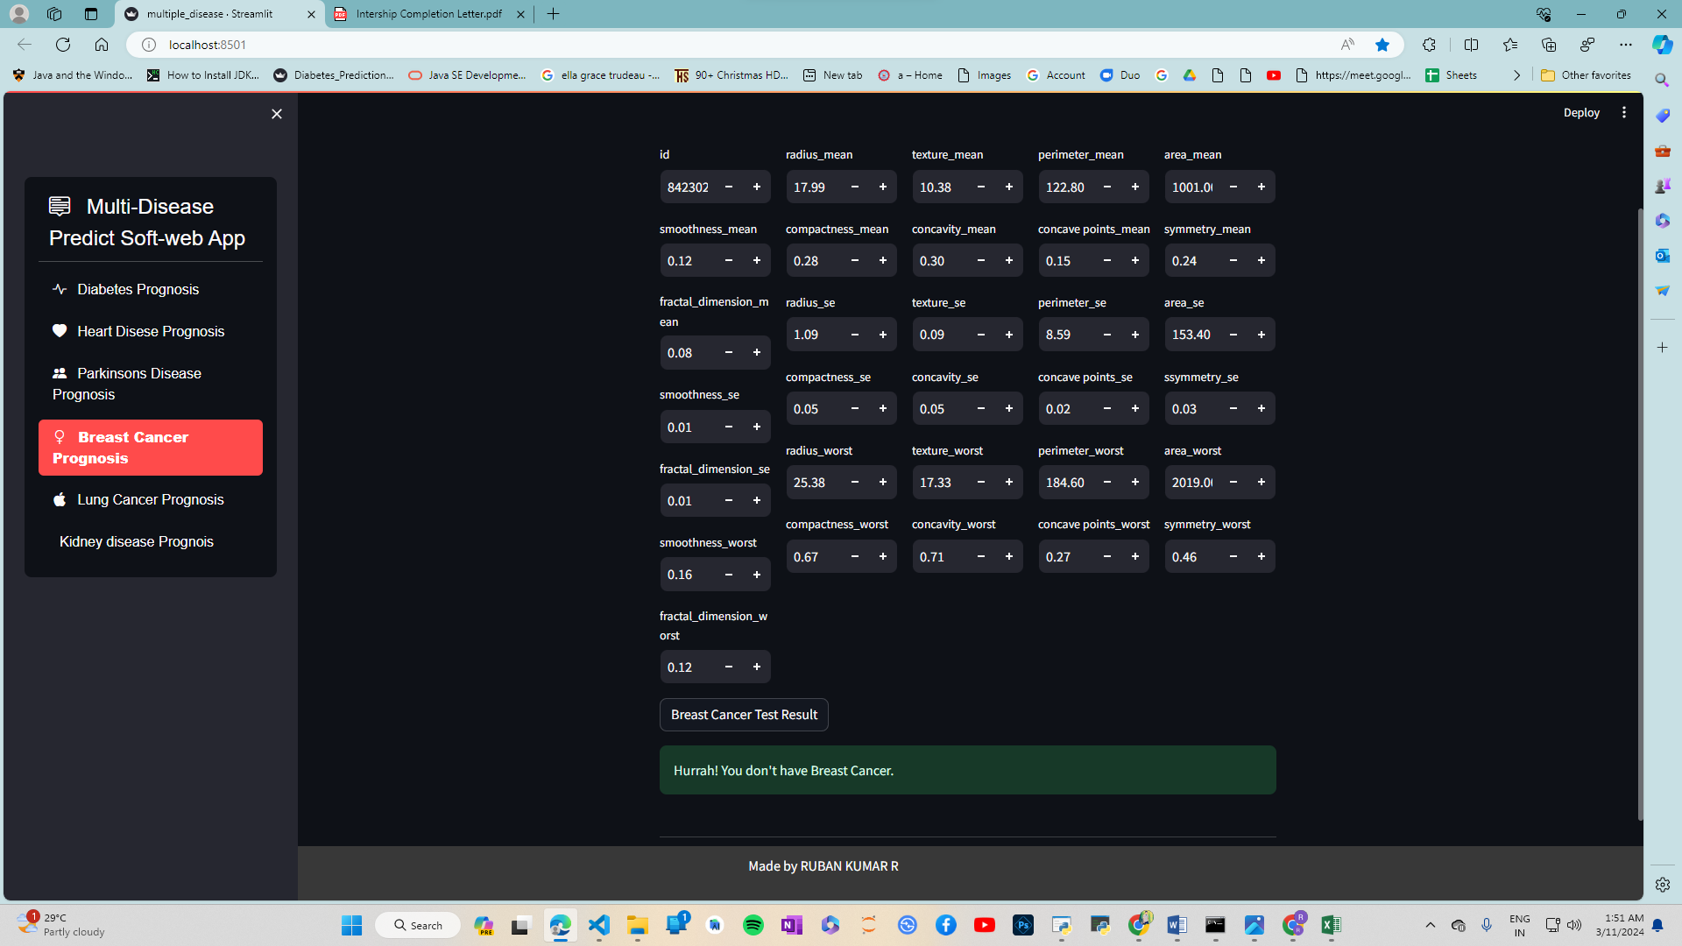
Input and Output Screen Shots
For breast cancer

Slide 18
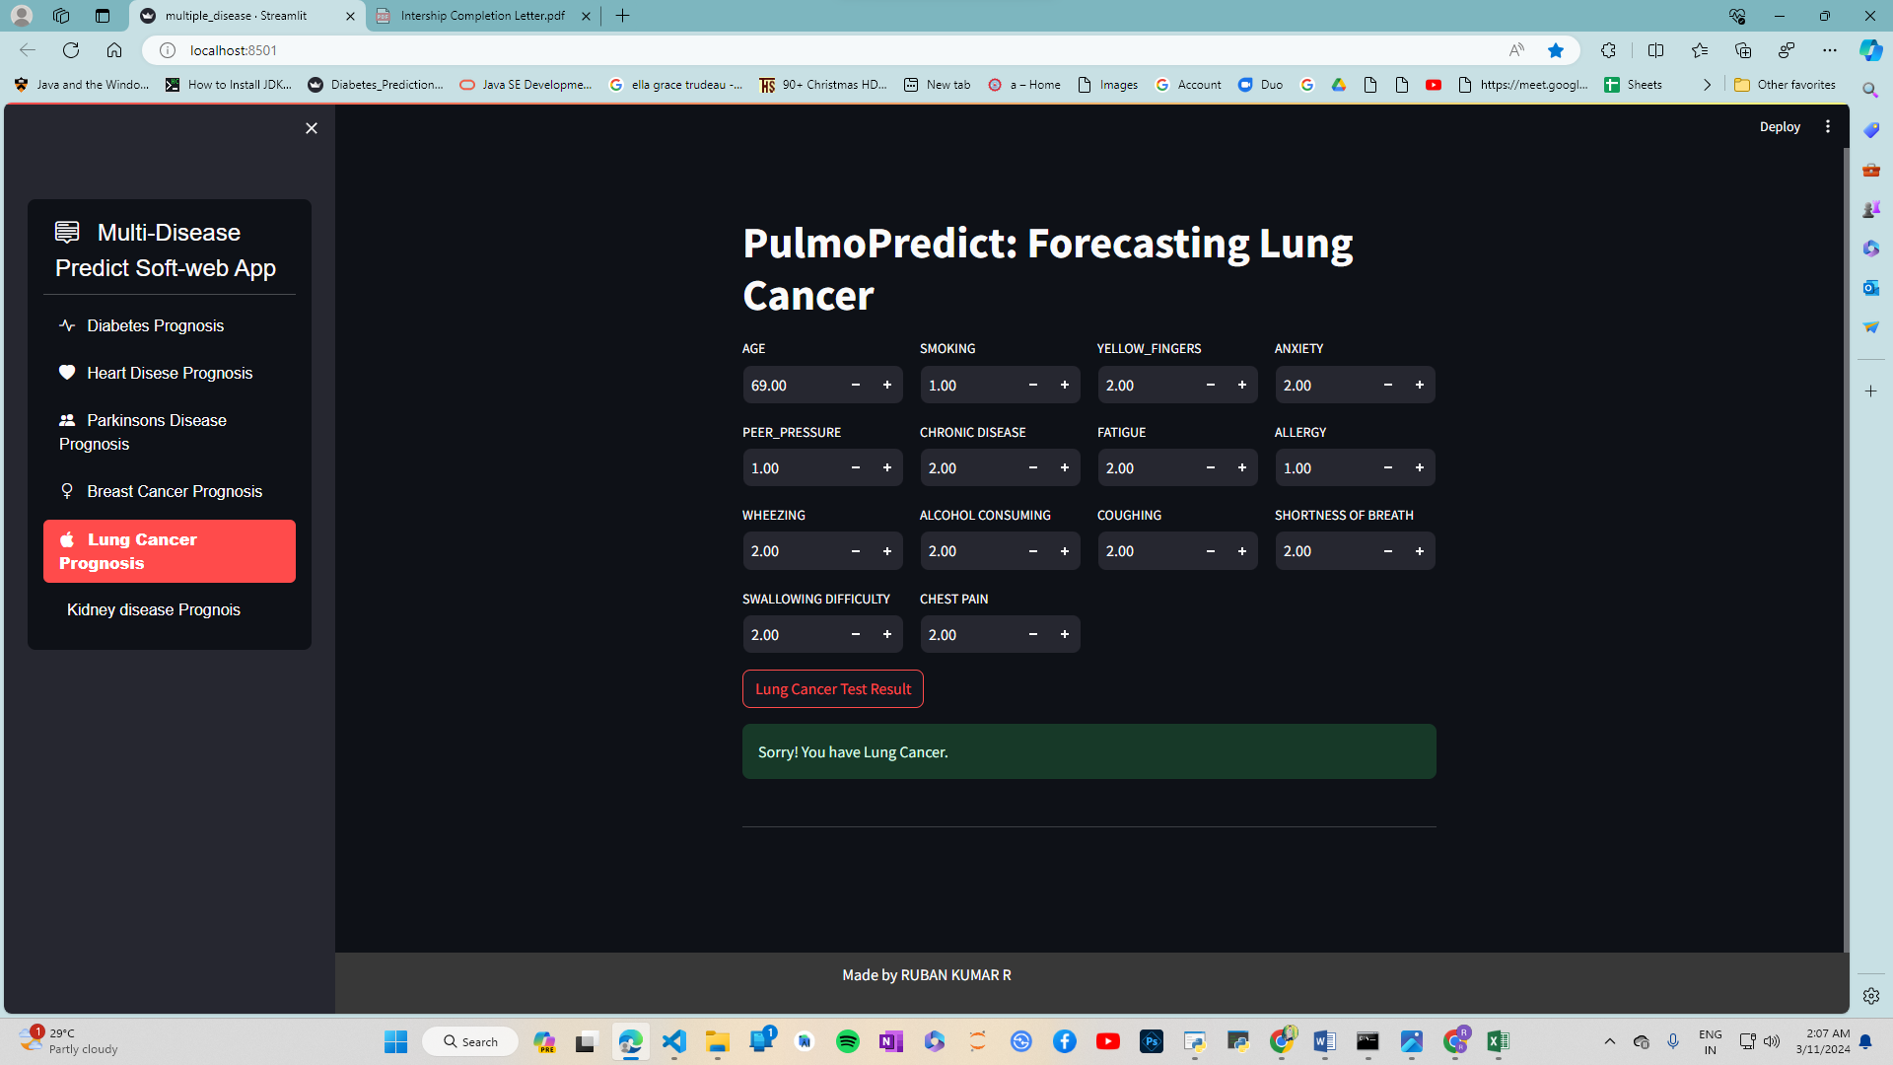

Input and Output Screen Shots
For lung cancer

Slide 19
This paper gives investigate of different inquires about done in this field. Our Proposed Framework points at bridging crevice between Specialists and Patients which will offer assistance both classes of clients in accomplishing their objectives.
By giving Doctor’s suggestion in our framework, we guarantee user’s believe side by side guaranteeing that the Doctor’s will not feel that their Commerce is getting influenced due to this System
MULTI-DISEASE PREDICT SOFT-WEB
The essential point of this venture was to create a framework competent of precisely anticipating different maladies. By accomplishing this objective, we have killed the require for clients to visit numerous websites, sparing them important time. Convenient infection expectation can essentially increment life hope and anticipate money related burdens.
APPLICATION
Results
system's capacity to give productive and exact expectations has the potential to upgrade healthcare get to, move forward quiet results, and eventually spare lives.

Slide 20
CONCLUSION
Point No: 01
This project of multiple done in this field. Our Proposed System aims at bridging gap between Doctors and Patients which will help both classes of users in achieving their goals.
Point No: 03
The present approach of many systems focuses only on automating this process which lacks in building the user's trust in the system.
Point No: 02
This system provides support for multiple disease prediction using different Machine Learning algorithms.
Point No: 04
By providing Doctors recommendation in our system, we ensure users trust side by side ensuring that the Doctors will not feel that their Business is getting affected due to this System

Slide 21
Reference:
1. Authors: John Smith, Emily Johnson
Application of Machine Learning in Disease Prediction: A Review
Application of Machine Learning in Disease Prediction: A Review
2. Authors: Sarah Thompson, Michael Davis
Predictive Modeling for Heart Disease Detection Using Machine Learning Techniques
Predicting Breast Cancer Risk Using Machine Learning Techniques: A Review
Predictive Modeling for Heart Disease Detection Using Machine Learning Techniques
3. Authors: Jennifer Brown, David Wilson
Multi-Disease Predict Soft-Web App
Machine Learning Approaches for Diabetes Prediction and Risk Factor Identification
Machine Learning Approaches for Diabetes Prediction and Risk Factor Identification
4. Authors: Robert Garcia, Amanda Martinez
Machine Learning Techniques for Lung Cancer Prediction: A Comprehensive Review
Early Detection of Parkinson's Disease Using Machine Learning Techniques
Early Detection of Parkinson's Disease Using Machine Learning Techniques
5. Authors: Daniel White, Olivia Harris
Machine Learning Techniques for Lung Cancer Prediction: A Comprehensive Review
6. Authors: Emma Clark, Sophia Roberts
Predicting Breast Cancer Risk Using Machine Learning Techniques: A Review

Slide 22
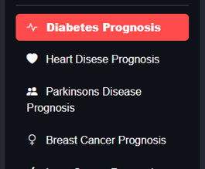
Multi-Disease
Predict soft-web App
Ruban Kumar R
Thank you for your time and attention during the viva

